Slide 1
Week 6 – CSS3 and Bootstrap

Slide 2
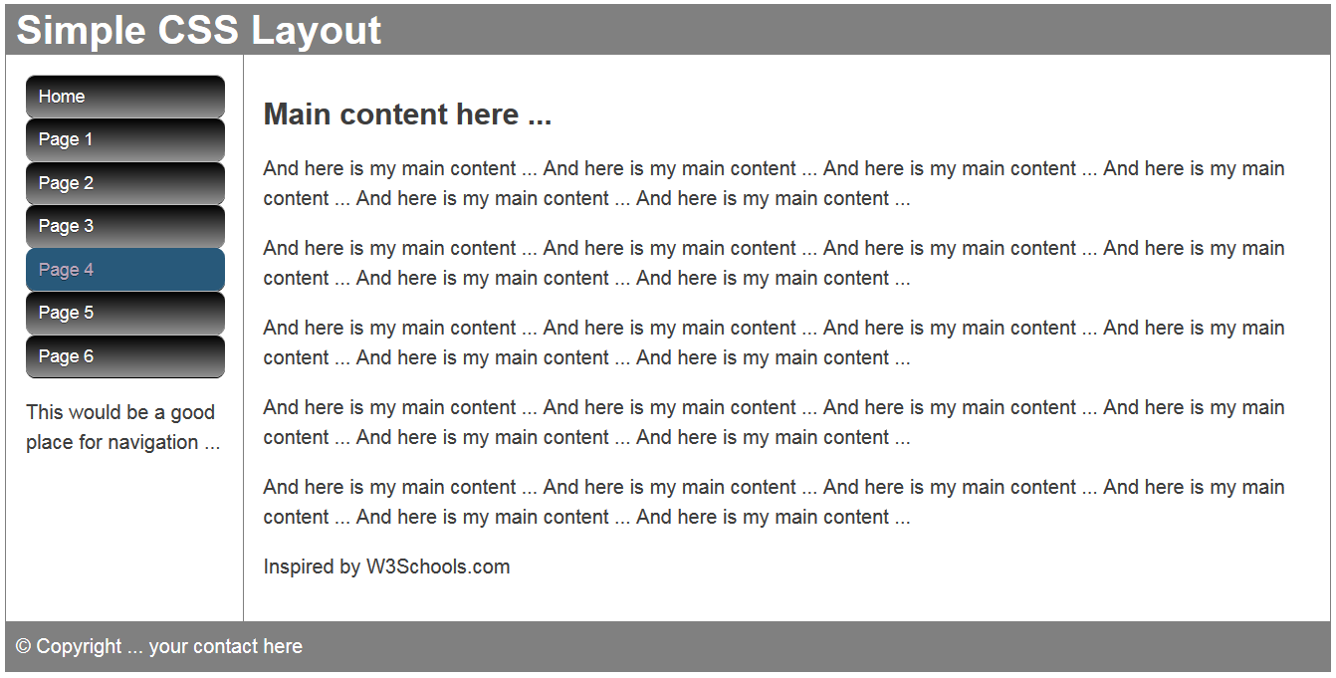
CSS3
CSS3 provides greater graphic control with features such as radius and gradient
Follow the hyperlink to the above and examine the CSS comments …

Slide 3
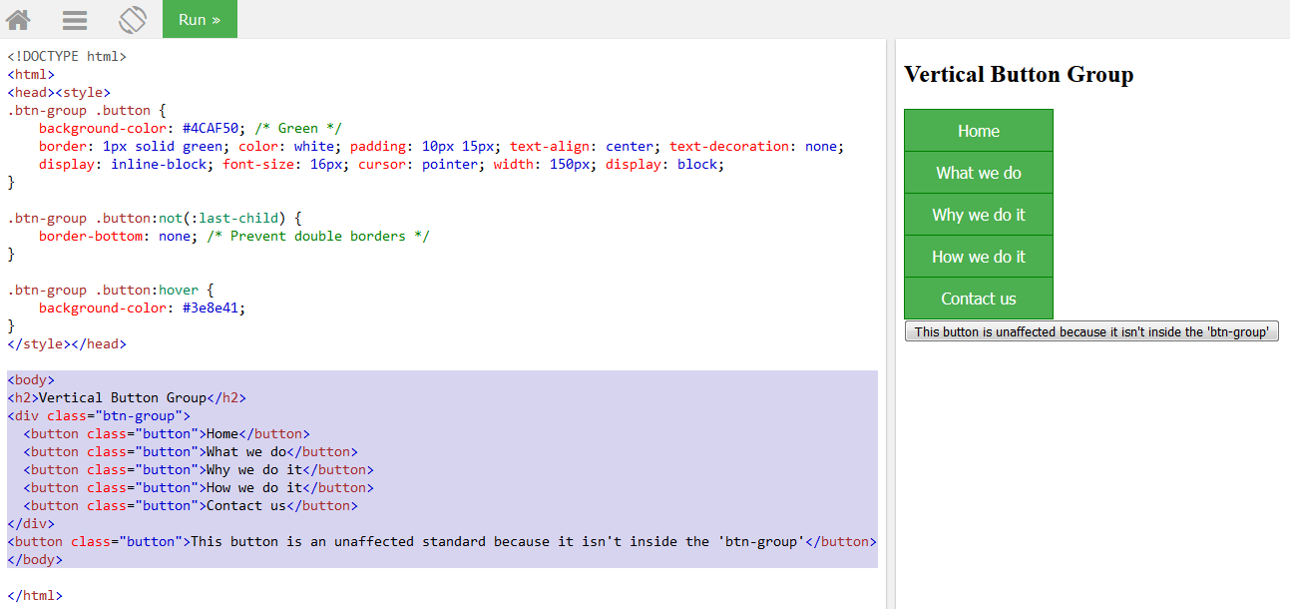
Now preferable to use <button> elements …
Examine the following … have a go at … https://www.w3schools.com/css/tryit.asp?filename=trycss_buttons_group_vertical

Slide 4
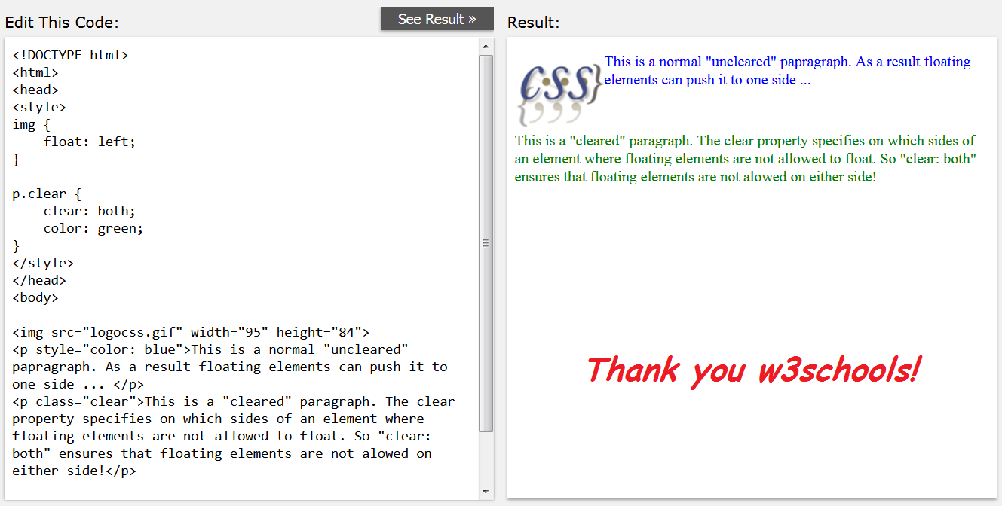
The importance of being clear

Slide 5
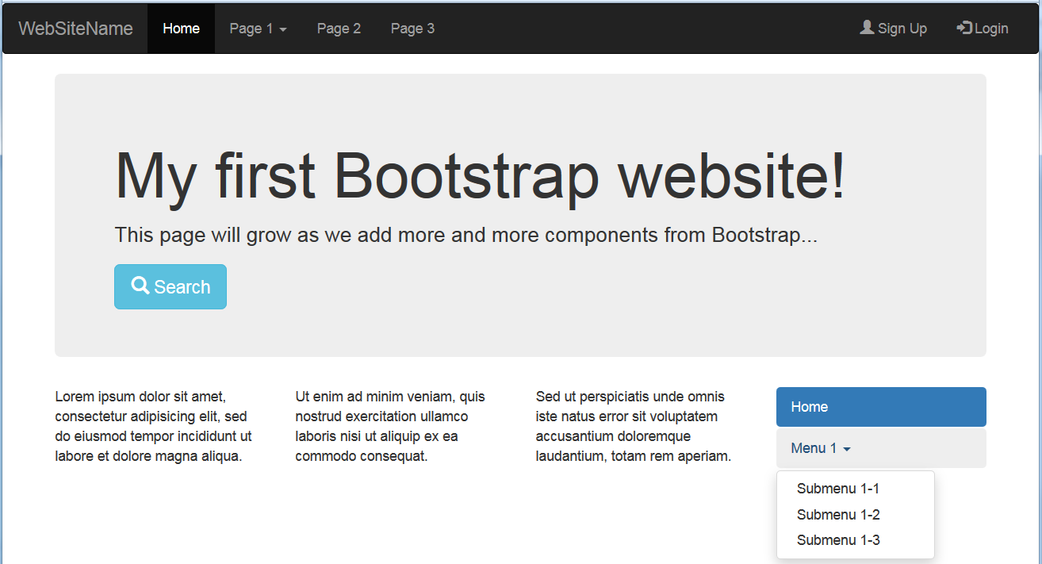
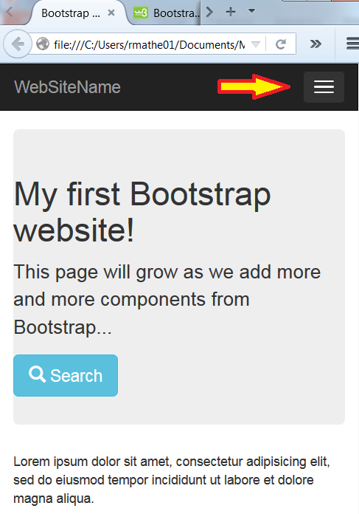
Framework layouts
Widely used to reduce cross-browser CSS inconsistency maintenance headaches!
JQuery, JQuery mobile and Bootstrap offer great layouts that are also mobile sensitive
These collapse navigation and automatically re-render other elements to fit screen or window size
Follow hyperlink to inspect link to frameworks …
Also explore W3Schools Bootstrap templates and themes …
… here … https://www.w3schools.com/bootstrap/bootstrap_templates.asp

Slide 6
Bootstrap is Ready-to-use Web Elements HTML / CSS elements for button, form, table, image, navbar, label, progress bar, alert etc

Slide 7
Why Bootstrap?
Save 100+ hours of coding
Easy to use web elements
Quick responsive prototype / website
Great documentation

Slide 8
Bootstrap Package
CSS - bootstrap.css
JS - bootstrap.js
Icon Fonts - glyphicons-halflings-regular.ttf

Slide 9
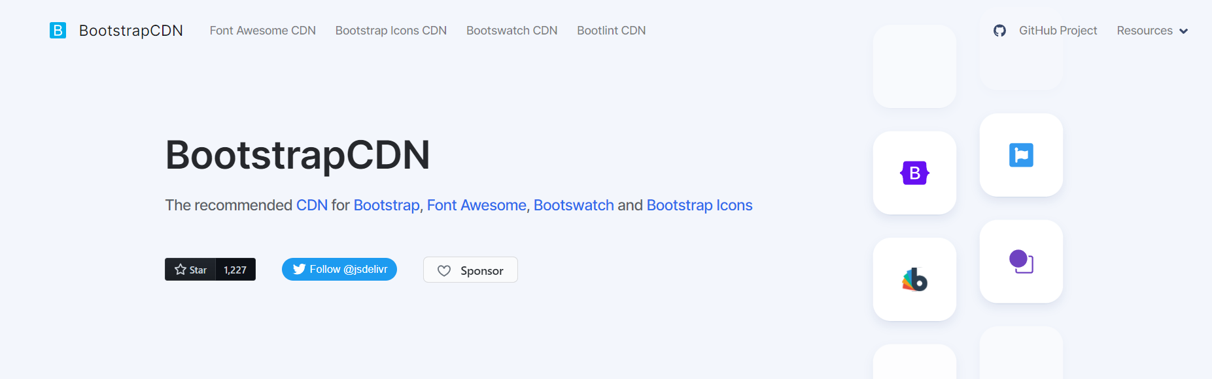
BootstrapCDN

Slide 10
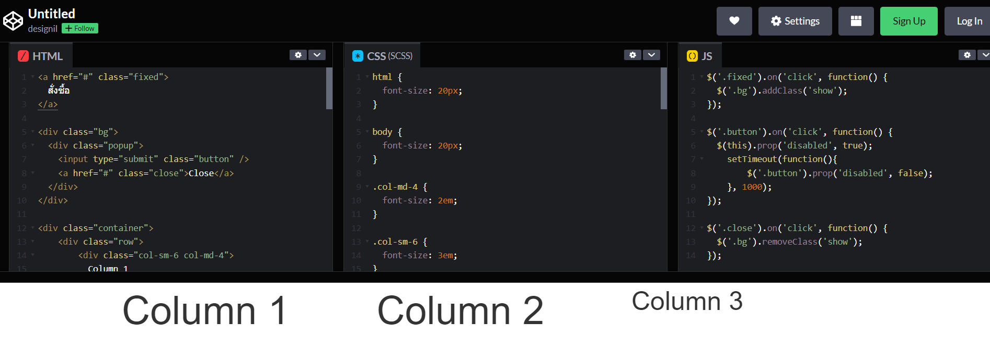
Bootstrap Playground https://codepen.io/designil/pen/qBYLMq

Slide 11
References and sources
Create CSS buttons quickly here http://www.thesitewizard.com/wizards/css-menu-buttons.shtml or here http://css-tricks.com/examples/ButtonMaker/#
Learn about float problems and the need to “clear” floats http://css-tricks.com/all-about-floats/
Online book covering many aspects of design http://www.webstyleguide.com/
Mark Newhouse’s solutions to CSS navigation http://alistapart.com/article/taminglists
Ross Shannon on many CSS subjects including changing the look of browser scroll bars http://www.yourhtmlsource.com/stylesheets
Wikipedia on CSS http://en.wikipedia.org/wiki/Cascading_Style_Sheets
Nick Rigby on CSS dropdown menus http://www.alistapart.com/articles/horizdropdowns
Matthew James Taylor’s layouts and navigation http://matthewjamestaylor.com/blog/perfect-multi-column-liquid-layouts
W3C The Box Model http://www.w3.org/TR/CSS2/box.html
W3Schools The Box Model (and introduction to Bootstrap) http://www.w3schools.com/css/tryit.asp?filename=trycss_boxmodel_width
A nice progressive tutorial on layout http://learnlayout.com

